Slide 1


Ambekeshwar Group Of Instutation, Lucknow
CIVIL ENGINEERING
SESSIONS 2023-24
PRESENTATION ON SUMMER TRAINING
ROAD CONSTRUCTION OF A FLEXIBLE PAVEMENT

Slide 2

INTRODUCTION
Training department: PWD, Bahraich
Incharge:
Period: 08/08/2023 to 04/09/2023
Location: BAHRAICH -271801
Specification of road:
Type of Road: National Highway
Length of Road: 3km
Width of Road: 10m (4 lane)
Cost:40crore

Slide 3
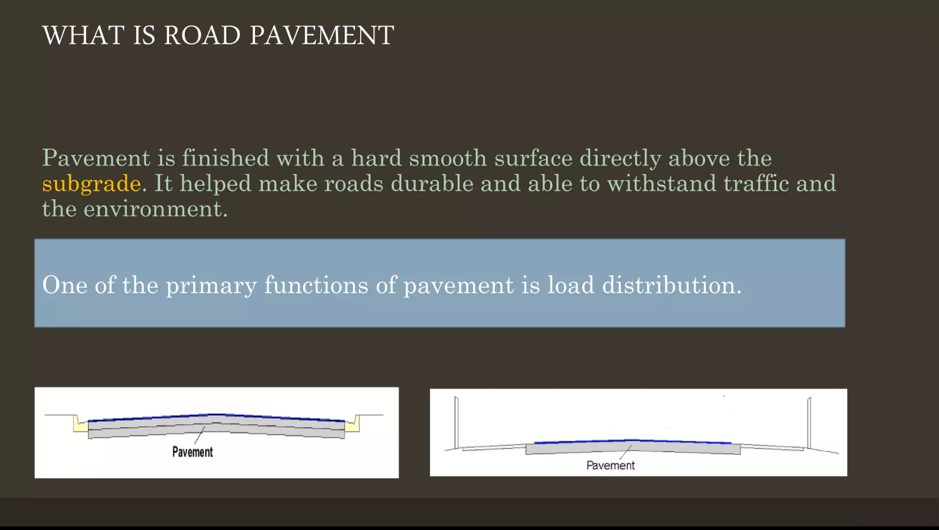

Slide 4
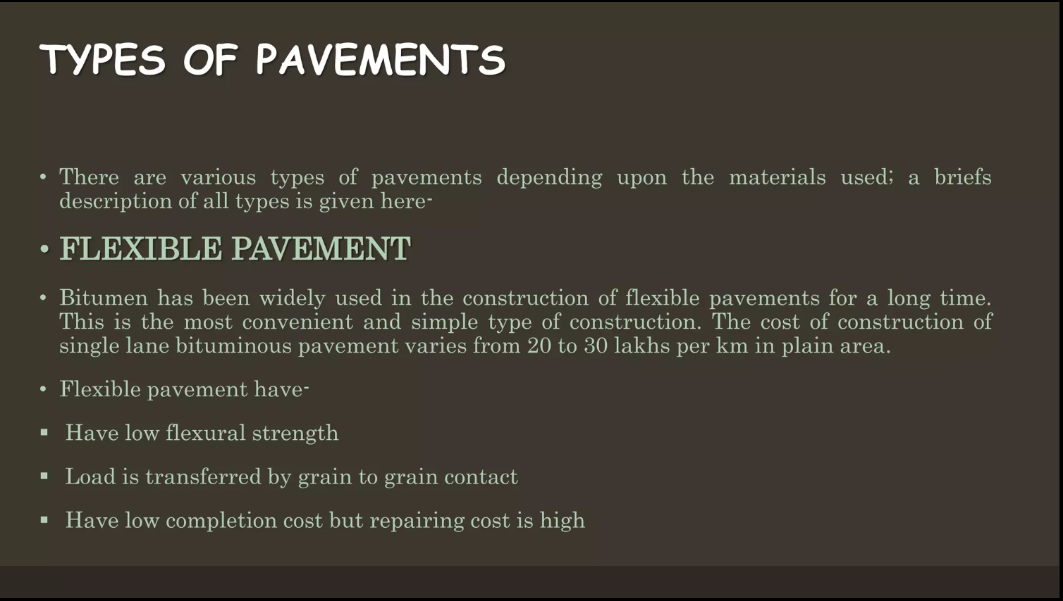

Slide 5
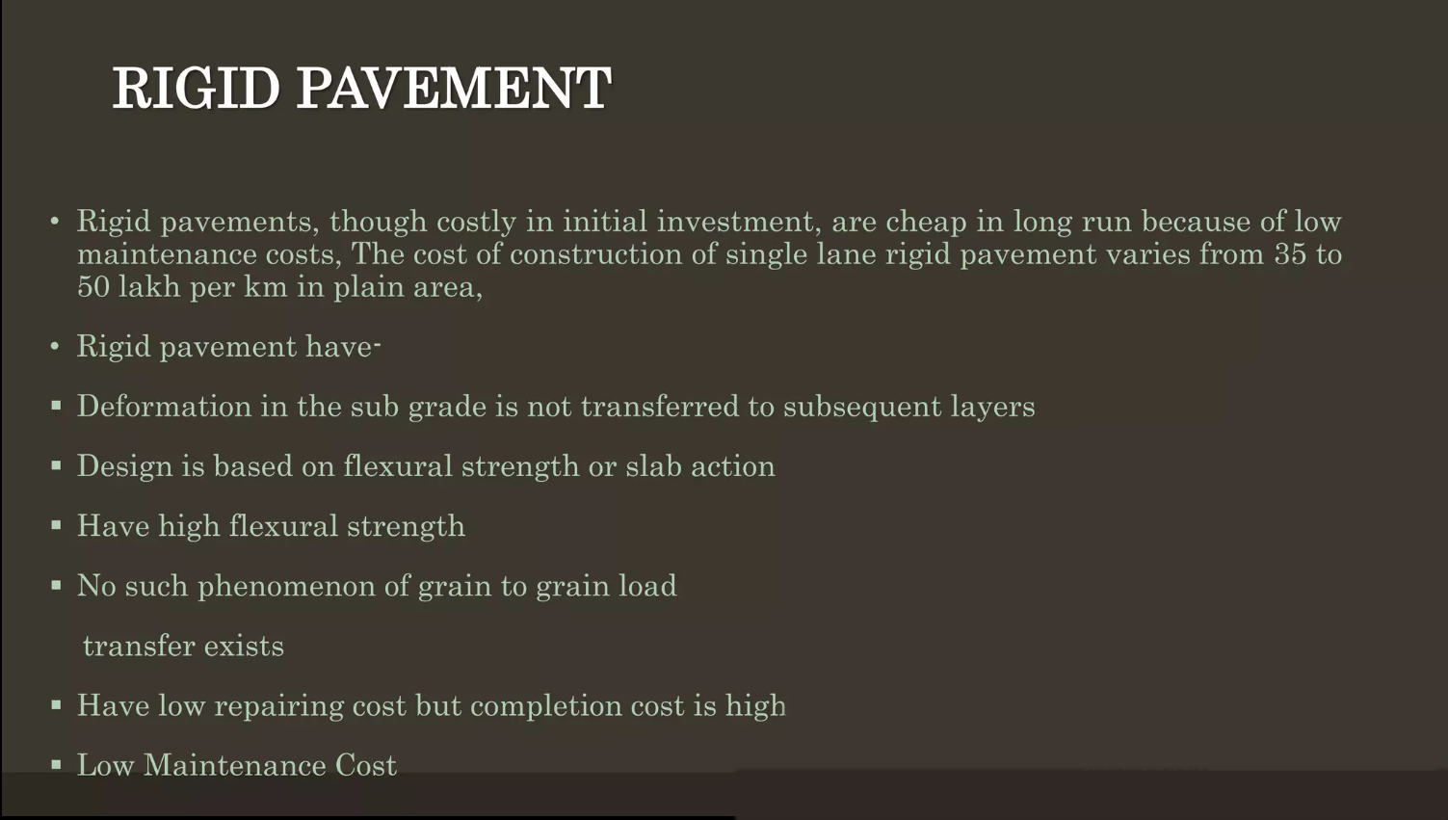

Slide 6

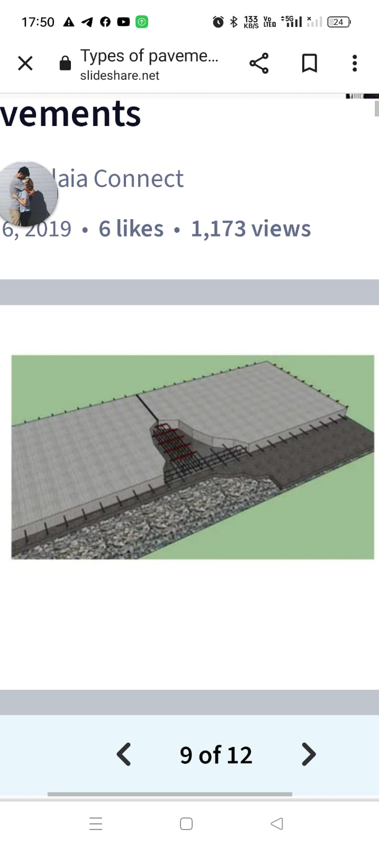
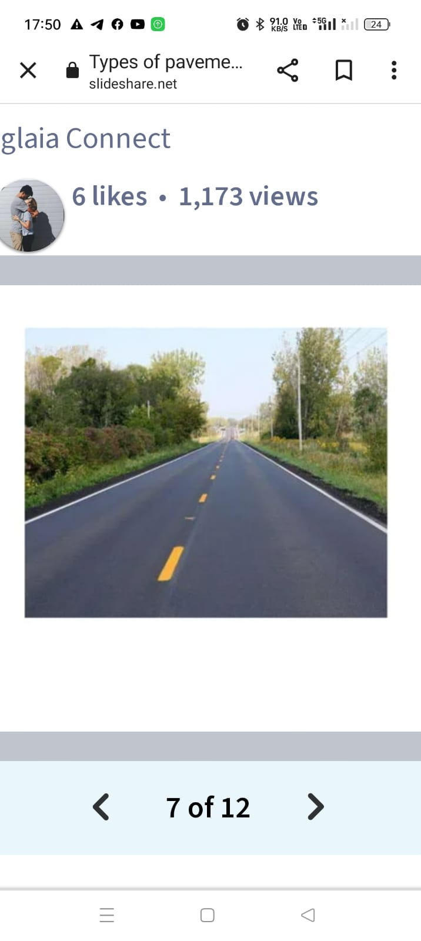
Rigid Pavement Flexible Pavement

Slide 7
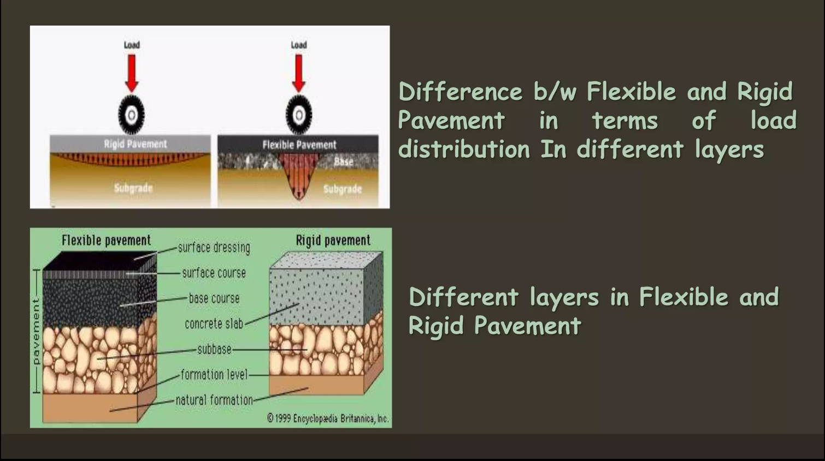

Slide 8
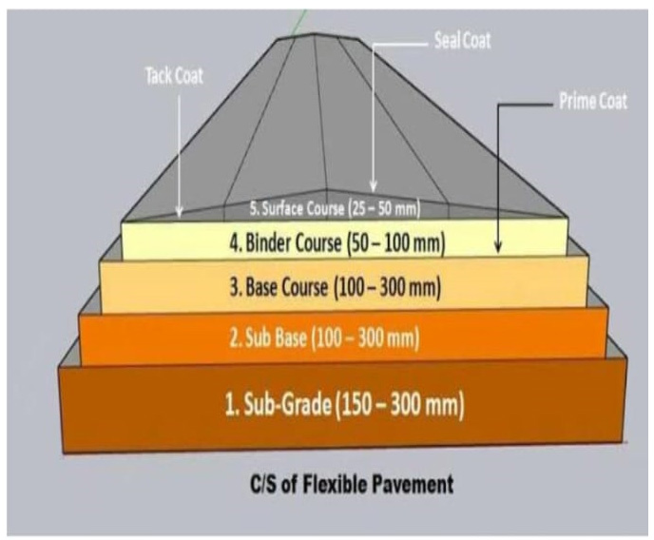
Concept of flexible PAVEment
Soil Subgrade
Sub Base Course
Base Course
Surface Course

Slide 9
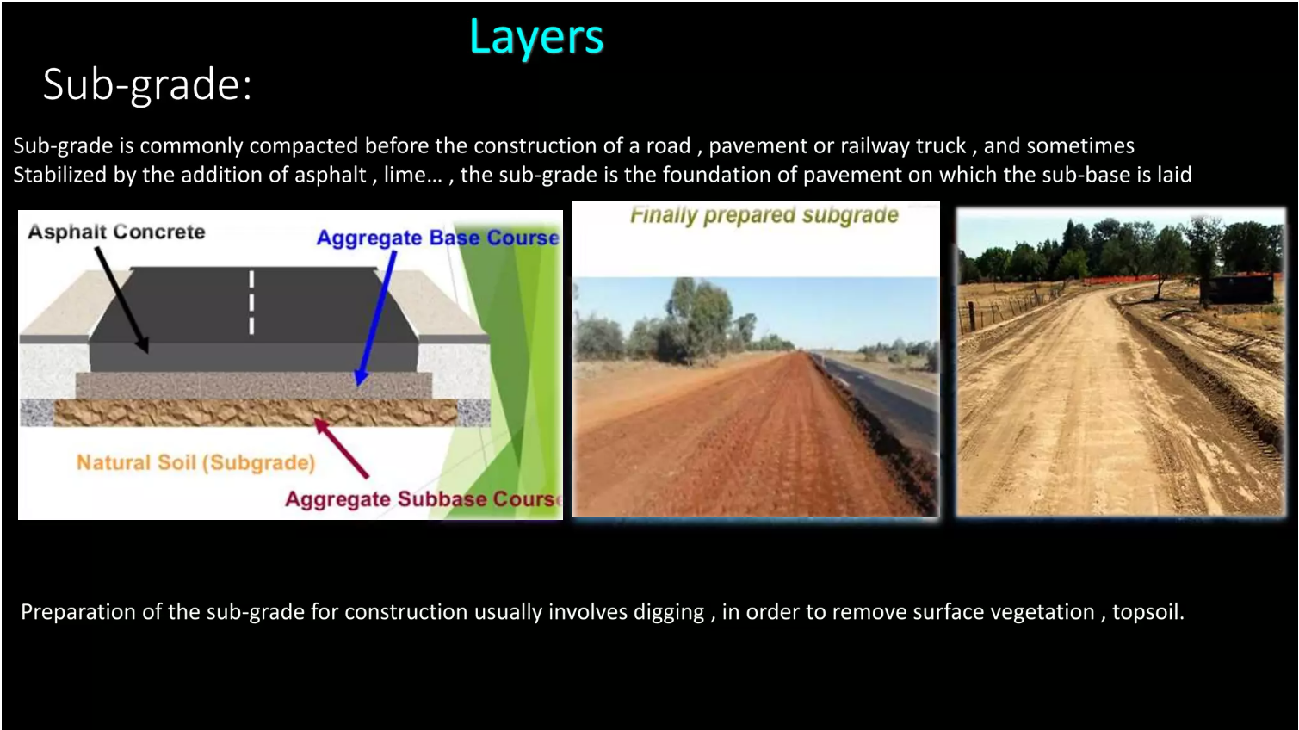

Slide 10
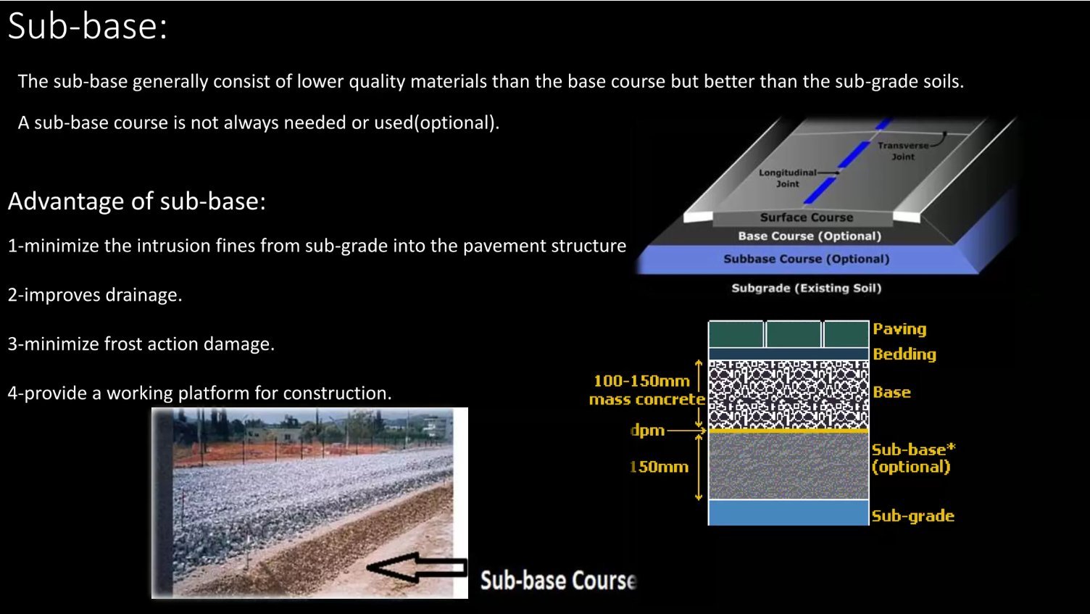

Slide 11
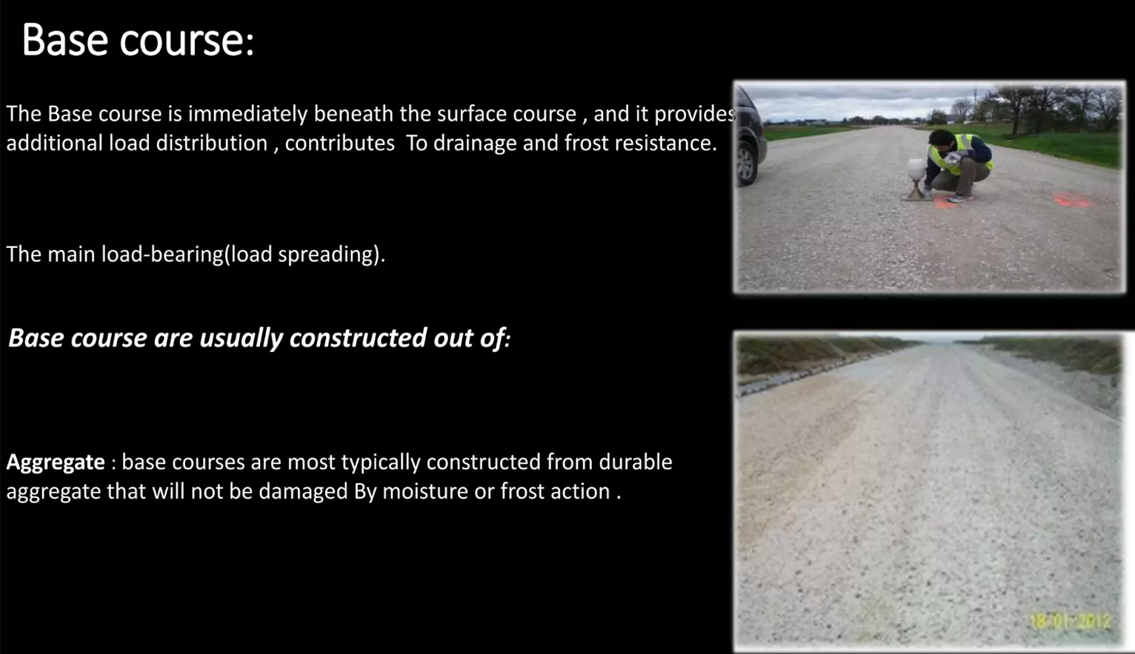

Slide 12


Slide 13
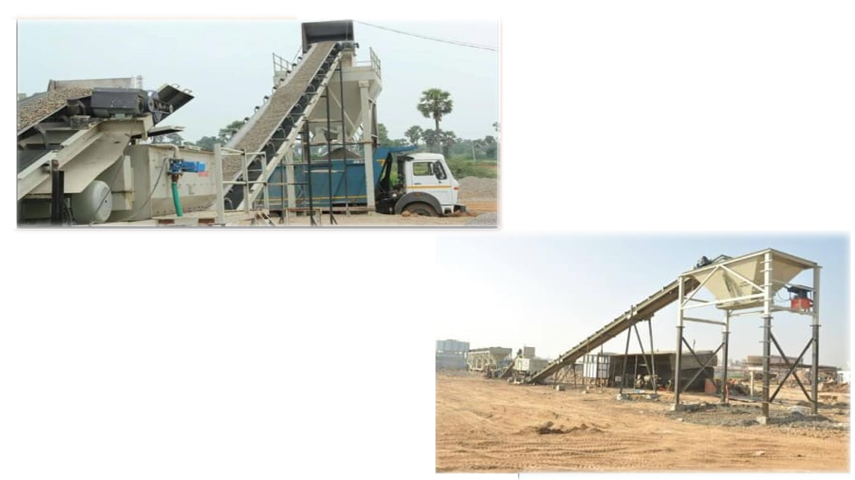
WET MIX MACADAM PLANT
Stone Dust
+
Water
+
Bitumen

Slide 14
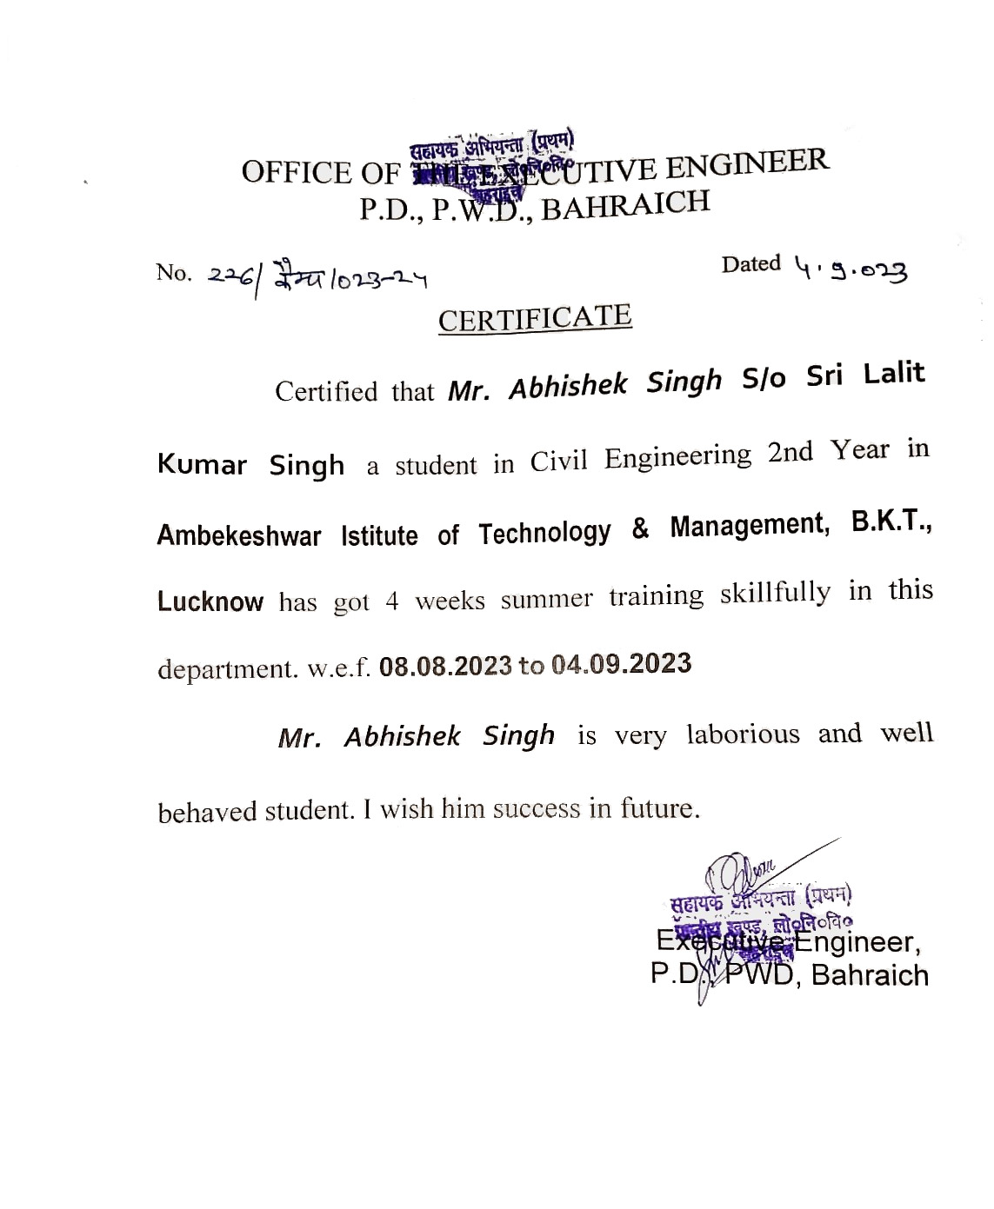

Slide 15


